Slide 1
Functional Dependencies
&
Normalization for
Relational Databases

Slide 2
Outline
Design Guidelines for Relational Databases
Functional Dependencies (FD)s
Normal Forms Based on Primary Keys
General Definitions of Second and Third Normal Forms
Boyce-Codd Normal Form (BCNF)
Designing a Set of Relations
Properties of Relational Decompositions
Algorithms for Relational Database Schema
Multivalued Dependencies and Fourth Normal Form
Join Dependencies and Fifth Normal Form

Slide 3
Relational Database Design
Relational database design: The grouping of attributes to form "good" relation schemas
Two levels of relation schemas:
  The logical "user view" level
  The storage "base relation" level
Design is concerned mainly with base relations,
not with view relations.

Slide 4
Design Guidelines for
Relational Databases
Initially, attributes are grouped to form a relation schema by using a common sense of the DB designer.
We need some measure to determine why one grouping of attributes into a relation schema may be better than another.

Slide 5
Design Guidelines for
Relational Databases (cont’d)
Criteria for "good" base relations:
  Informal guidelines for good relational design
  Formal concepts that allow us to do relational design in a top-down fashion, i.e. design by analysis. These formal concepts are:
    Functional dependencies (FDs)
    Normal forms (1NF, 2NF, 3NF and BCNF).

Slide 6
Informal Design Guidelines for Relation Schemas
Four informal measures of quality for relation schema design
  Semantics of the relation attributes
  2. Reducing the redundant values in tuples
  3. Reducing the null values in tuples
  4. Disallowing the possibility of generating spurious tuples

Slide 7
Semantics of the Relation Attributes
Semantics specifies:
  how to interpret the attribute values stored in a tuple of the relation
  or how the attribute values in a tuple relate to one another (e.g., the meaning of the EMPLOYEE relation schema is simple and DNUMBER is a FK that represents an implicit relationship between EMPLOYEE and DEPARTMENT).

Slide 8
Semantics of the Relation Attributes (cont’d)
  Only FKs should be used to refer to other entities.
  Entity and relationship attributes should be kept apart as much as possible.
  Design a schema that can be explained easily relation by relation. The semantics of attributes should be easy to interpret.
GUIDELINE 1: Design a relation schema so that it is easy to explain its meaning. Do not combine attributes from multiple entity types and relationship types into a single relation.

Slide 9
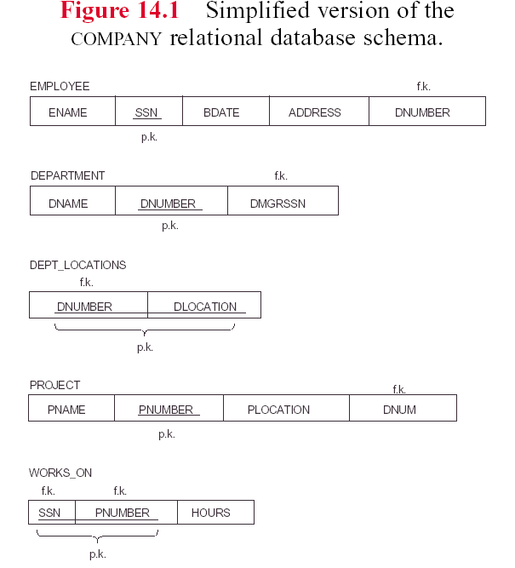

Slide 10
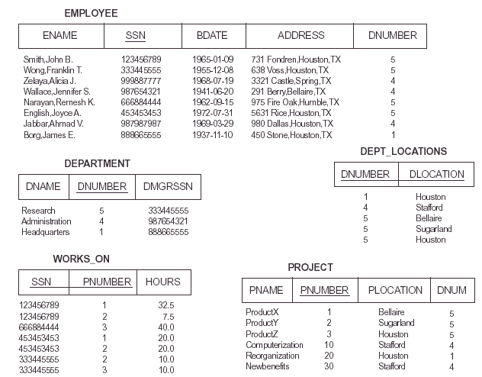

Slide 11
Reducing the Redundant Values in Tuples
One goal of schema is to minimize the storage space
that the base relations (files) occupy.
Grouping attributes into relation schemas saves
storage.

Slide 12
Reducing the Redundant Values in Tuples (cont’d)
Ex: Consider the following relation EMP_DEPT which JOINs
EMPLOYEE and DEPARTMENT
(ENAME, SSN, BDATE, ADDRESS, DNUMBER, DNAME, DMGRSSN)
Problems:
Redundancy: Attribute values of (DNUMBER,DNAME,
DMGRSSN) are repeated for every employee who works
in a particular department.
Update anomalies: Occurs when we try to modify data.

Slide 13
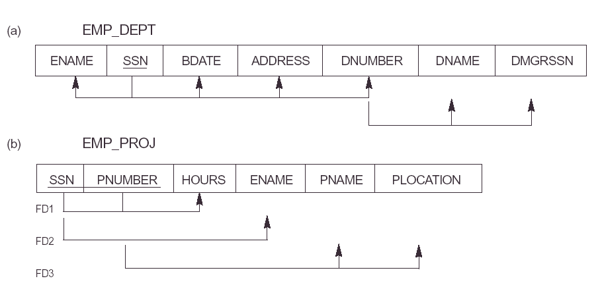

Slide 14
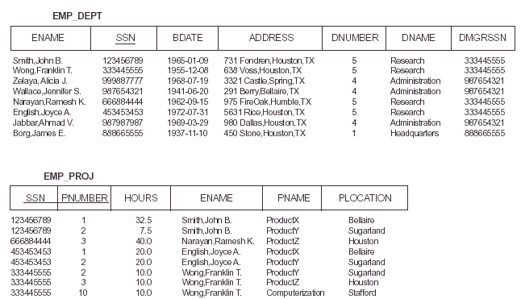

Slide 15
Update Anomalies
Insertion Anomalies: (e.g., to insert a new department that has no employee as yet in the relation - because SSN cannot be null)
Deletion Anomalies: (e.g., delete the last employee working for a particular department).
Modication Anomalies: (e.g., change of the manager of a department requires to update the tuples of all employees who work in that department).

Slide 16
Update Anomalies (cont’d)
GUIDELINE 2: Design a schema that does not suffer from the insertion, deletion and update anomalies. If there are any present, then note them so that applications can be made to take them into account.

Slide 17
Reducing the Null Values in Tuples
Nulls can have multiple interpretation
The attribute does not apply to this tuple
The attribute value for this tuple is unknown
The value in known but absent - it has not been recorded
Having too many nulls may lead to problems with understanding the meaning of the attributes and applying the JOIN.
GUIDELINE 3: Relations should be designed such that their tuples will have as few NULL values as possible.

Slide 18
Generation of Spurious Tuples
Consider the relations:
EMP_LOCS(ENAME, PLOCATION) and
EMP_PROJ1(SSN, PNUMBER, HOURS, PNAME, PLOCATION)
If we attempt a NATURAL JOIN operation on these relations the result produces many spurious tuples!!
GUIDELINE 4: Design relation schemas so that they can be Joined with equality conditions on attributes that are either primary keys or foreign keys in a way that guarantees that no spurious tuples are generated.

Slide 19
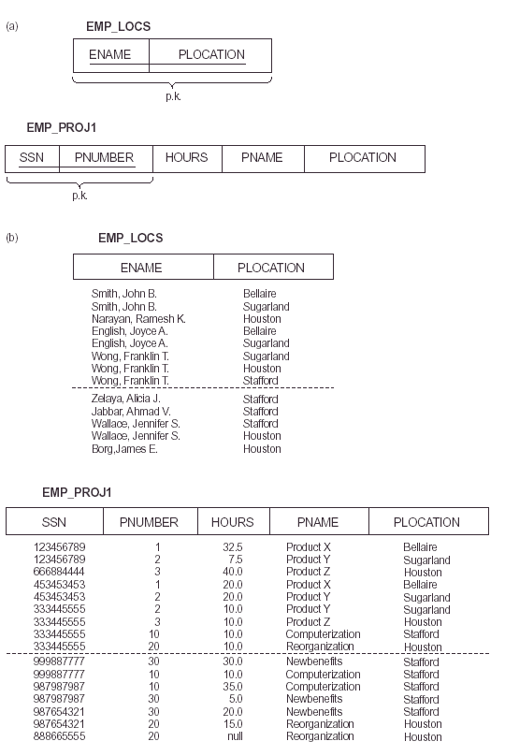

Slide 20
Functional Dependencies (FD)
Functional dependencies (FDs) are used to specify formal measures of the "goodness" of relational designs.
FDs and keys are used to define normal forms for relations.
FDs are constraints that are derived from the meaning and interrelationships of the data attributes.
A set of attributes X functionally determines a set of attributes Y if the value of X determines a unique value for Y.
R(X,Y,Z,A)
X→Y
Y→Z
XZ→A

Slide 21
Functional Dependencies (cont’d)
A FD denoted by X→Y between two sets of attributes X and Y that are subsets of R specifies a constraint on the possible tuples that can form a relation state r of R.
The constraint is that for any two tuples t₁ and t₂ in r that have t₁[X] =t₂[X], we must also have t₁[Y] =t₂[Y].
Ex:
SSN→LNAME
Specifies that the value of an employee’s SSN uniquely
determines the employee’s last name (or, alternatively, LNAME is functionally dependent on SSN.

Slide 22
Inference Rules in Functional Dependencies
We denote by F the set of FDs that are specified on relation schema R.
An FD X→Y is inferred from F if X→Y holds in every relation state r that is a legal extension of R; that is, whenever r satisfies all the dependencies in F, X→Y also holds in r.
We use the notation F╞ X→Y to denote that the functional dependency X → Y is inferred from the set of functional dependencies F. The set of such dependencies is called the closure of F and is denoted by F⁺.

Slide 23
Inference Rules for FDs
Given a set of FDs F, we can infer additional FDs that hold whenever the FDs in F hold the following:
Armstrong's inference rules:
  A1. (Reflexive):
  If Y subset-of X, then X → Y
  A2. (Augmentation):
  If X → Y, then XZ → YZ
  (Notation: XZ stands for X U Z)
  A3. (Transitive):
  If X → Y and Y → Z, then X → Z

Slide 24
Additional Useful Inference Rules
Decomposition
  If X → YZ, then X → Y and X → Z
Union
  If X → Y and X → Z, then X → YZ
Psuedotransitivity
  If X → Y and WY → Z, then WX → Z

Slide 25
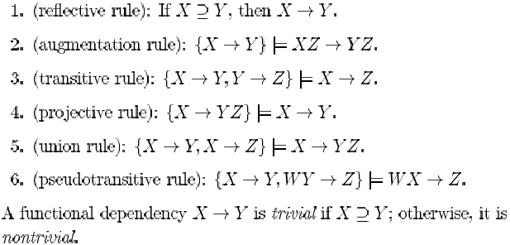
Inference Rules for FDs Together

Slide 26
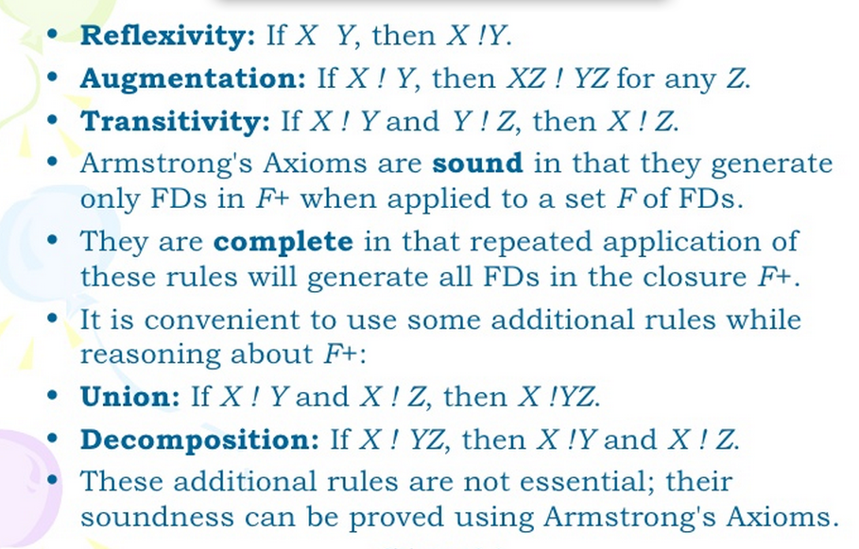


Slide 27
Closure
Closure of a set F of FDs is the set F⁺ of all FDs that can be inferred from F.
X⁺ is called the closure of attribute X under F – X⁺ is set of attributes that are functionally determined by X based on F.

Slide 28
Closure
Algorithm:
X⁺ = X
Repeat
oldX⁺ = X⁺
for each functional dependency Y->Z in F do
if Y is subset of X⁺ then X⁺ = X⁺ U Z
Until (X⁺ = oldX⁺ )

Slide 29
Exercise
F={ssn->ename,
  pnumber->{pname, ploc},
  {ssn,pnumber}->hours}
  Calculate
{ssn}+ → {ssn,ename,hours,pname,ploc}
  {pnumber}^{+→{pnumber,pname,ploc,hours}}
  {ssn,pnumber}+→{ssn,pnumber,ename,pname,ploc,hours}

Slide 30
R(A,B,C,D,E,G)
AB→C
AC→B AB,C
AD→E
B→D
C→A
E→G
Find the closure and the candidate key in given set.
{AB} →{ABCDEG}
{AC} →{ACBDEG}
{AD}→{ADEG}
{B} →{BD}
{C}→{CABDEG}
{E}→{EG}

Slide 31
Equivalence of Sets of
Functional Dependencies
A set of functional dependencies E is covered by a set of functional dependencies F (or F is said to cover E) if every FD in Ε is also in F⁺.
Two sets of functional dependencies E and F are equivalent if:
Ε⁺ = F⁺
Ε and F are equivalent if Ε covers F and F covers Ε.

Slide 32
Minimal Sets of Functional Dependencies
A set of functional dependencies F is minimal if:
1. Every dependency in F has a single attribute for its right-hand side.
2. We cannot replace any dependency X→Y in F with a dependency Y→Z, where Y is a proper subset of X, and still have a set of dependencies that is equivalent to F.
3. We cannot remove any dependency from F and still have
a set of dependencies that is equivalent to F.
A minimal cover of a set of functional dependencies F is a minimal set of dependencies F_{min} that is equivalent to F.

Slide 33
Minimal Cover
Algorithm Finding a minimal cover F for a set of FDs E.
1. Set F := E.
2. Replace each functional dependency X->{A₁, A₂..A_{n}} in F by the n functional dependencies X->A₁ , X->A₂ ,… X->A_{n}.
3. For each functional dependency X->A in F
for each attribute B that is an element of X
if ((F - {X->A}) U {(X - {B}) ->A}) is equivalent to F,
then replace X->A with (X - {B}) ->A in F.
4. For each remaining functional dependency X->A in F if (F - {X->A}) is equivalent to F,
then remove X->A from f.

Slide 34
Normal Forms Based on Primary Keys
The normalization process takes a relation schema through a series of tests to “certify” whether it satisfies a certain normal form.
Normalization of data can be looked upon as a process of analyzing the given relation schemas based on their FDs and primary keys to achieve the desirable properties of:
  minimizing redundancy and
  minimizing the insertion, deletion and update anomalies.

Slide 35
Definitions of Keys and Attributes Participating in Keys
A superkey of a relation schema R = {A₁, A₂, ...., A_{n}} is a set of attributes S subset-of R with the property that no two tuples t₁ and t₂ in any legal relation state r of R will have t₁[S] = t₂[S]
A key (minimal superkey) K is a superkey with the additional property that removal of any attribute from K will cause K not to be a superkey any more.

Slide 36
Definitions of Keys and Attributes Participating in Keys
If a relation schema has more than one key, each is called a candidate key. One of the candidate keys is arbitrarily designated to be the primary key, and the others are called secondary keys.
A Prime attribute must be a member of some candidate key
A Nonprime attribute is not a prime attribute—that is, it is not a member of any candidate key.

Slide 37
First Normal Form (1NF)
States that the domain of an attribute must include only atomic (indivisible) values and that the value of any attribute in a tuple must be a single value from the domain of that attribute.
Disallow composite attributes, multivalued attributes, and nested relations (attributes whose values for an individual tuple are non-atomic).

Slide 38
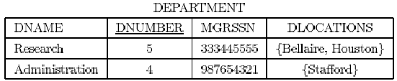
First Normal Form (1NF) – cont’d
Consider the following relation (Fig. 14.8 (b)):
As we can see this is not in 1NF because DELOCATIONS is not an atomic attribute.

Slide 39
3 main techniques to achieve 1NF for such a relation:
Remove the attribute DLOCATIONS that violates 1NF and place it in a separate relation along with the primary key DNUMBER of DEPARTMENT.
Expand the key so that there will be a separate tuple in the original DEPARTMENT relation for each location of a DEPARTMENT (the primary key becomes the combination {DNUMBER, DLOCATIONS}). This solution has the disadvantage of introducing redundancy in the relation.

Slide 40
3 main techniques to achieve 1NF for such a relation:
3. If a maximum number of values is known for the attribute replace the DLOCATIONS attribute by those cases (e.g., DLOCATION1, DLOCATION2, and DLOCATION3). This solution has the disadvantage of introducing null values if most departments have fewer than three locations.

Slide 41
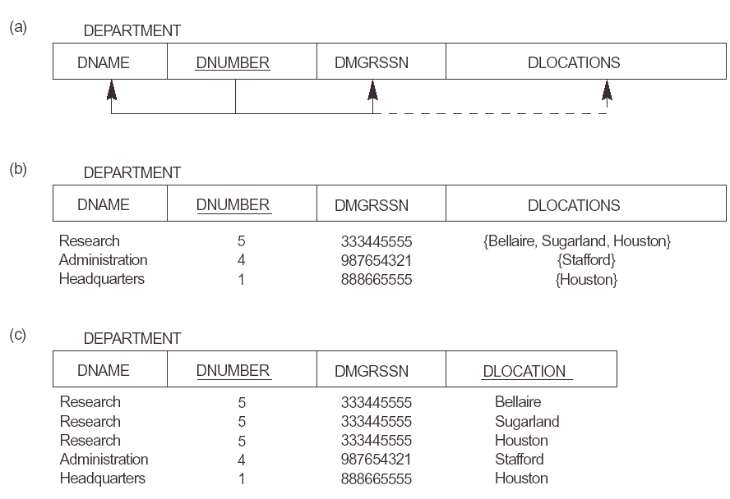
Example for 1NF

Slide 42
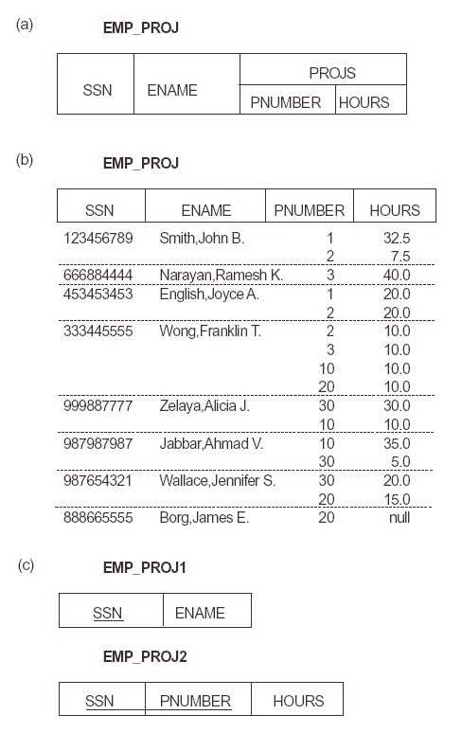

Slide 43
Second Normal Form (2NF)
Uses the concepts of FDs and primary key.
Required Definitions:
  Prime attribute - attribute that is member of the primary key K.
  Non-prime attribute -
  Full functional dependency

Slide 44

Definition: Full Functional Dependency
A functional dependency X→Y is a full functional dependency if removal of any attribute A from X means that the dependency does not hold any more (i.e., for all A Є X, (X-{A}) does not functionally determine Y.
Otherwise, X→Y is partial dependency.
Ex:
the functional dependency {ESSN, PNO} →HOURS
is a fully functional dependency since neither ESSN -> HOURS nor PNO -> HOURS hold
- {ESSN, PNUMBER} -> ENAME is not a full FD (it is called a partial dependency ) since ESSN -> ENAME also holds

Slide 45
Second Normal Form (2NF) –cont’d
A relation schema R is in 2NF if every non-prime attribute A in R is fully functionally dependent on the primary key of R.
Ex: The relation
EMP_PROJ(SSN, PNO, HOURS, ENAME, PNAME, PLOCATION)
is in 1NF but is not in 2NF.
The non-prime attribute ENAME violates 2NF because of
FD2: SSN →ENAME
FD3: PNO→{PNAME, PLOCATION}

Slide 46
Second Normal Form (2NF) –cont’d
If a relation schema is not in 2NF it can be 2NF-normalized into a number of 2NF relations (by decompositions) such that non-prime attributes are associated only with the part of the PK on which they are fully functionally dependent.
For instance EMP_PROJ(SSN, PNO, HOURS, ENAME, PNAME, PLOCATION) could be decomposed into:
EP1(SSN, PNO, HOURS)
EP2(SSN, ENAME) and
EP3(PNO, PNAME, PLOCATION).

Slide 47
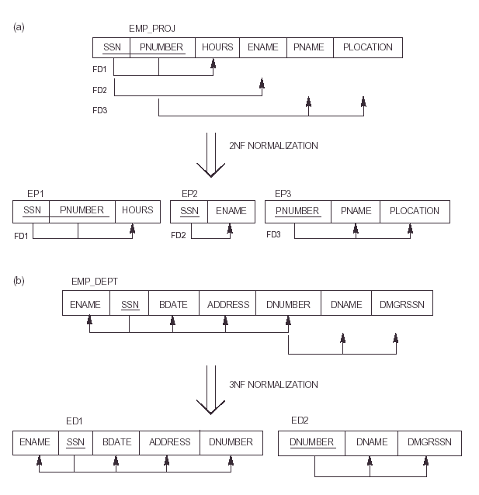

Slide 48
Definition:
Transitive Functional Dependency
  An FD X → Y is transitive if there is a set of attributes Z that are neither a candidate key nor a subset of any key of R, and both X → Z and Z → Y holds.
Examples:
SSN → DMGRSSN is a transitive FD since
SSN → DNUMBER and DNUMBER → DMGRSSN hold.
SSN → ENAME is non-transitive since there is no set of
attributes X where SSN → X and X → ENAME.

Slide 49
Third Normal Form (3NF)
A relation schema R is in 3NF if it satisfies 2NF and no non-prime attribute of R is transitively dependent on the PK.
Ex: The relation
EMP_DEPT(ENAME, SSN, BDATE, ADDRESS, DNO, DNAME, MGRSSN)
is in 2NF since no partial dependencies on a key exist. However, it is not in 3NF because of the transitive dependency of DMGRSSN (and also DNAME) on SSN via DNUMBER.

Slide 50
Third Normal Form (3NF) –cont’d
We can normalize
EMP_DEPT(ENAME, SSN, BDATE, ADDRESS, DNO, DNAME, MGRSSN)
by decomposing it into the two 3NF relation schemas :
ED1(ENAME, SSN, BDATE, ADDRESS, DNUMBER)
ED2(DNUMBER, DNAME, MGRSSN).

Slide 51
General Definitions of
Second and Third Normal Forms
A relation schema R is in 2NF if every non-prime attribute A Є R is not partially dependent on any key of R.
A relation schema R is in 3NF if whenever a non-trivial functional dependency X→A holds in R, either
  X is a superkey of R or
  A is a prime attribute of R

Slide 52
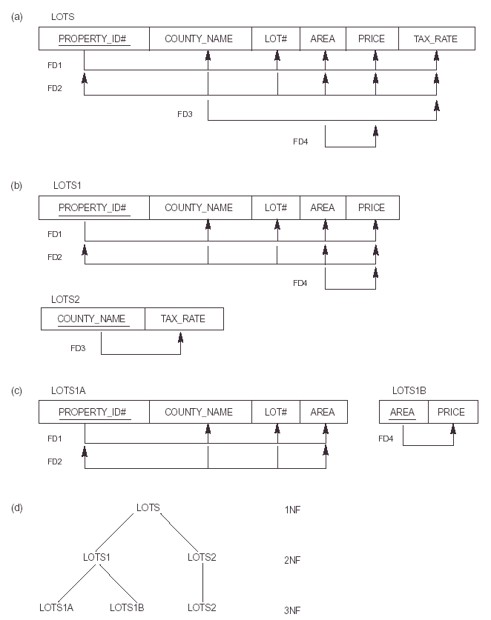

Slide 53
Boyce-Codd Normal Form (BCNF)
A relation schema R is in BCNF if whenever a non-trivial functional dependency X→A holds in R, then X is a superkey of R.
The only difference between the definitions of BCNF and 3NF is that the 3NF allows A to be prime. That is, every relation in BCNF is also a 3NF; however, a relation in 3NF is not necessarily in BCNF.

Slide 54
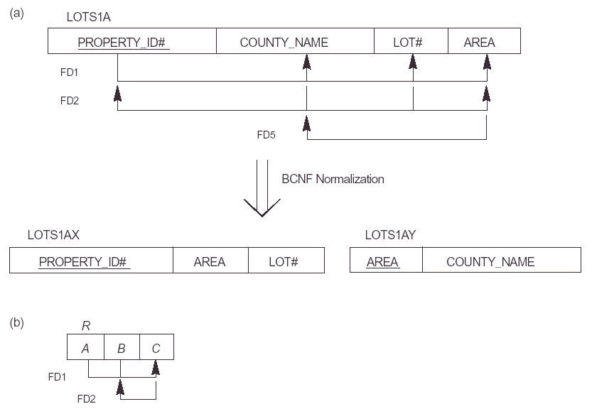

Slide 55
More on Normal Forms
  Each normal form is strictly stronger than the previous one:
    Every 2NF relation is in 1NF
    Every 3NF relation is in 2NF
    Every BCNF relation is in 3NF
  There exist relations that are in 3NF but not in BCNF
  The goal is to have each relation in BCNF (or 3NF)

Slide 56
Properties of Relational Decompositions
Dependency Preservation Property of a Decomposition
    A decomposition D = {R1, R2, ..., Rm} of R is dependency-preserving with respect to F if the union of the projections of F on each Ri in D is equivalent to F; that is
    ((π_{R1}(F)) υ . . . υ (π_{Rm}(F)))⁺ = F⁺
Claim :
  It is always possible to find a dependency-preserving decomposition D with respect to F such that each relation Ri in D is in 3NF.

Slide 57
Properties of Relational Decompositions
Lossless (Non-additive) Join Property of a Decomposition:
  Definition: a decomposition D = {R1, R2, ..., Rm} of R has the lossless (nonadditive) join property with respect to the set of dependencies F on R if, for every relation state r of R that satisfies F, the following holds, where * is the natural join of all the relations in D:
* (π _{R1}(r), ..., π_{Rm}(r)) = r

Slide 58
Lossless (Non-additive) Join Property of a Decomposition
Testing for Lossless Join Property
  Input: A universal relation R, a decomposition D = {R1, R2, ..., Rm} of R, and a set F of functional dependencies.
1. Create an initial matrix S with one row i for each relation Ri in D, and one column j for each attribute Aj in R.
2. Set S(i,j):=bij for all matrix entries. (* each bij is a distinct symbol associated with indices (i,j) *).
3. For each row i representing relation schema Ri
{for each column j representing attribute Aj
{if (relation Ri includes attribute Aj) then set S(i,j):= aj;};};
  (* each aj is a distinct symbol associated with index (j) *)

Slide 59
Lossless (Non-additive) Join Property of a Decomposition
Testing for Lossless Join Property
4. Repeat the following loop until a complete loop execution results in no changes to S
{for each functional dependency X Y in F
{for all rows in S which have the same symbols in the columns corresponding to attributes in X
{make the symbols in each column that correspond to an attribute in Y be the same in all these rows as follows:
If any of the rows has an “a” symbol for the column, set the other rows to that same “a” symbol in the column.
If no “a” symbol exists for the attribute in any of the rows, choose one of the “b” symbols that appear in one of the rows for the attribute and set the other rows to that same “b” symbol in the column ;};
};
};
5. If a row is made up entirely of “a” symbols, then the decomposition has the lossless join property; otherwise it does not.

Slide 60
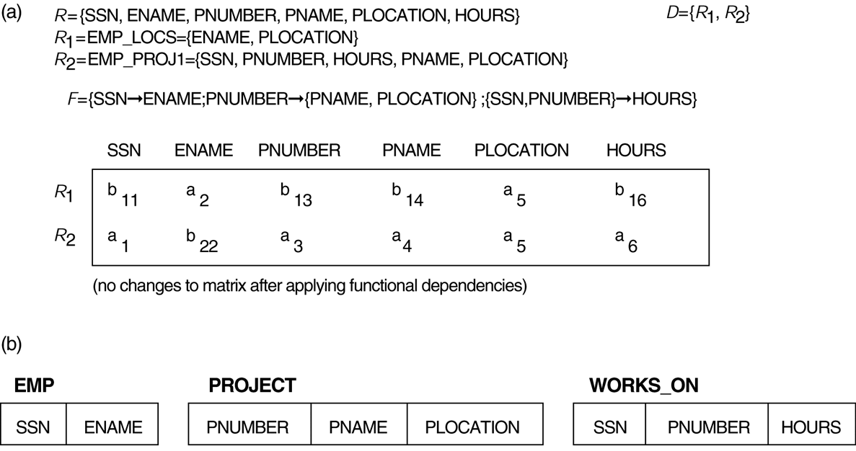
Properties of Relational Decompositions
Lossless (nonadditive) join test for n-ary decompositions.
(a) Case 1: Decomposition of EMP_PROJ into EMP_PROJ1 and EMP_LOCS fails test.
(b) A decomposition of EMP_PROJ that has the lossless join property.

Slide 61
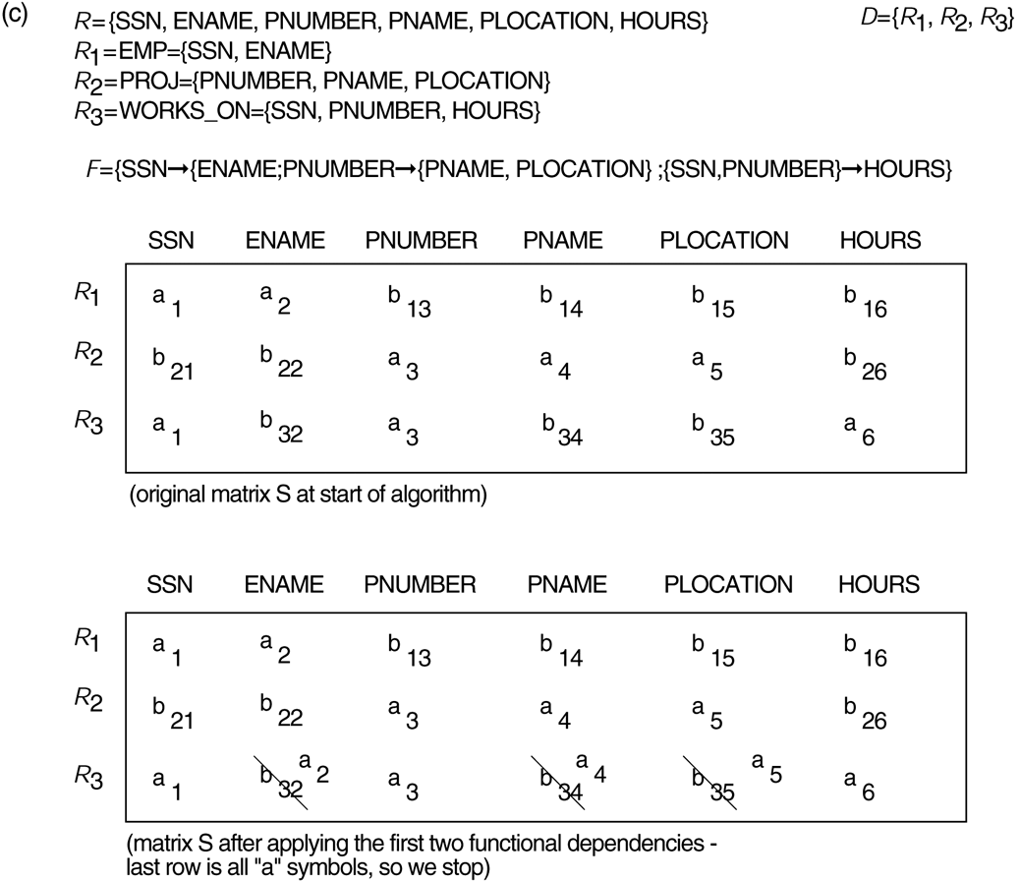
Properties of Relational Decompositions
Lossless (nonadditive) join test for n-ary decompositions.
(c) Case 2: Decomposition of EMP_PROJ into EMP, PROJECT, and WORKS_ON satisfies test.

Slide 62
Relational Synthesis into 3NF with Dependency Preservation
(Relational Synthesis Algorithm)
  Input: A universal relation R and a set of functional dependencies F on the attributes of R.
1. Find a minimal cover G for F;
2. For each left-hand-side X of a functional dependency that appears in G,
create a relation schema in D with attributes {X υ {A1} υ {A2} ... υ {Ak}},
where X  A1, X  A2, ..., X  Ak are the only dependencies in G with X as left-hand-side (X is the key of this relation) ;
3. Place any remaining attributes (that have not been placed in any relation) in a single relation schema to ensure the attribute preservation property.
  Claim : Every relation schema created by Algorithm is in 3NF.

Slide 63
Relational Decomposition into BCNF with Lossless (non-additive) join property
  Input: A universal relation R and a set of functional dependencies F on the attributes of R.
1. Set D := {R};
2. While there is a relation schema Q in D that is not in BCNF
do {
choose a relation schema Q in D that is not in BCNF;
find a functional dependency X  Y in Q that violates BCNF;
replace Q in D by two relation schemas (Q - Y) and (X υ Y);
};

Slide 64
Relational Synthesis into 3NF with Dependency Preservation and Lossless (Non-Additive) Join Property
Input: A universal relation R and a set of functional dependencies F on the attributes of R.
1. Find a minimal cover G for F
2. For each left-hand-side X of a functional dependency that appears in G,
create a relation schema in D with attributes {X υ {A1} υ {A2} ... υ {Ak}},
where X  A1, X  A2, ..., X –>Ak are the only dependencies in G with X as left-hand-side (X is the key of this relation).
3. If none of the relation schemas in D contains a key of R, then create one more relation schema in D that contains attributes that form a key of R. (Use Algorithm to find the key of R)

Slide 65
Finding a Key K for R Given a set F of Functional Dependencies
Input: A universal relation R and a set of functional dependencies F on the attributes of R.
1. Set K := R;
2. For each attribute A in K {
Compute (K - A)⁺ with respect to F;
If (K - A)⁺ contains all the attributes in R,
then set K := K - {A};
}

Slide 66
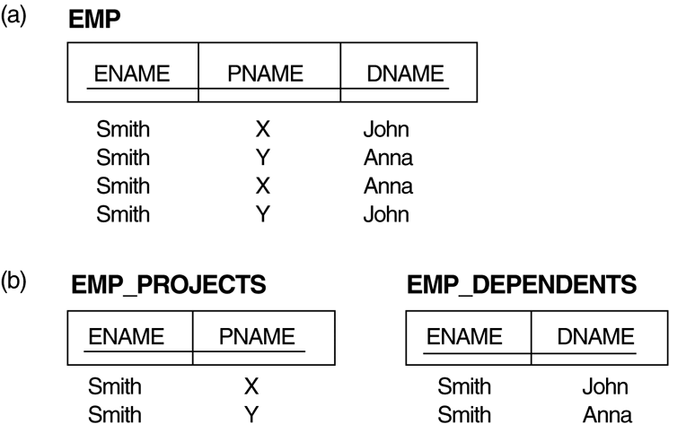
Multivalued Dependencies and Fourth Normal Form
The EMP relation with two MVDs: ENAME —>> PNAME and ENAME —>> DNAME.
Decomposing the EMP relation into two 4NF relations EMP_PROJECTS and EMP_DEPENDENTS.
  t₃[X] = t₄[X] = t₁[X] = t₂[X].
  t₃[Y] = t₁[Y] and t₄[Y] = t₂[Y].
  t₃[Z] = t₂[Z] and t₄[Z] = t₁[Z].

Slide 67
Multivalued Dependencies and Fourth Normal Form
Definition:
A multivalued dependency (MVD) X —>> Y specified on relation schema R, where X and Y are both subsets of R, specifies the following constraint on any relation state r of R: If two tuples t₁ and t₂ exist in r such that t₁[X] = t₂[X], then two tuples t₃ and t₄ should also exist in r with the following properties, where we use Z to denote (R - (X υ Y)):
  t₃[X] = t₄[X] = t₁[X] = t₂[X].
  t₃[Y] = t₁[Y] and t₄[Y] = t₂[Y].
  t₃[Z] = t₂[Z] and t₄[Z] = t₁[Z].
An MVD X —>> Y in R is called a trivial MVD if (a) Y is a subset of X, or (b) X υ Y = R.

Slide 68
Multivalued Dependencies and Fourth Normal Form
Definition:
A relation schema R is in 4NF with respect to a set of dependencies F (that includes functional dependencies and multivalued dependencies) if, for every nontrivial multivalued dependency X —>> Y in F⁺, X is a superkey for R.

Slide 69
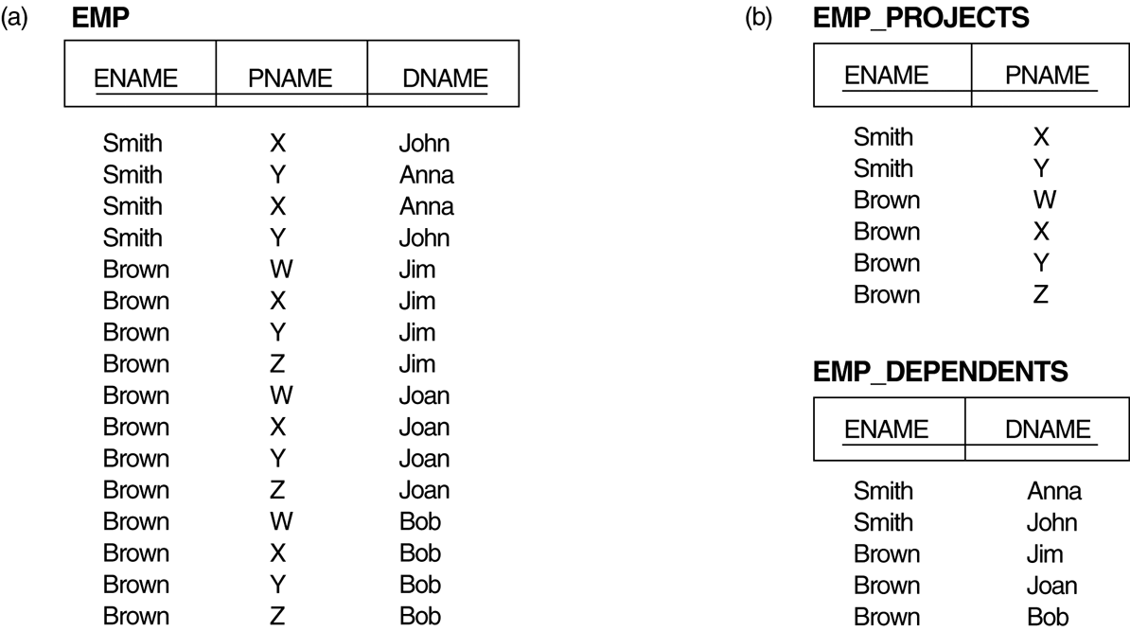
Multivalued Dependencies and Fourth Normal Form
Decomposing a relation state of EMP that is not in 4NF:
EMP relation with additional tuples.
Two corresponding 4NF relations EMP_PROJECTS and EMP_DEPENDENTS.

Slide 70
Multivalued Dependencies and Fourth Normal Form
Algorithm : Relational decomposition into 4NF relations with non-additive join property
Input: A universal relation R and a set of functional and multivalued dependencies F.
Set D := { R };
While there is a relation schema Q in D that is not in 4NF do {
choose a relation schema Q in D that is not in 4NF;
find a nontrivial MVD X —>> Y in Q that violates 4NF;
replace Q in D by two relation schemas (Q - Y) and (X υ Y);
};

Slide 71
Join Dependencies and Fifth Normal Form
Definition:
A join dependency (JD), denoted by JD(R₁, R₂, ..., R_{n}), specified on relation schema R, specifies a constraint on the states r of R.
  The constraint states that every legal state r of R should have a non-additive join decomposition into R₁, R₂, ..., R_{n}; that is, for every such r we have
  * (π_{R1}(r), π_{R2}(r), ..., π_{Rn}(r)) = r
Note: an MVD is a special case of a JD where n = 2.
A join dependency JD(R₁, R₂, ..., R_{n}), specified on relation schema R, is a trivial JD if one of the relation schemas R_{i} in JD(R₁, R₂, ..., R_{n}) is equal to R.

Slide 72
Join Dependencies and Fifth Normal Form
Definition:
A relation schema R is in fifth normal form (5NF) (or Project-Join Normal Form (PJNF)) with respect to a set F of functional, multivalued, and join dependencies if,
  for every nontrivial join dependency JD(R₁, R₂, ..., R_{n}) in F⁺ (that is, implied by F),
    every R_{i} is a superkey of R.

Slide 73
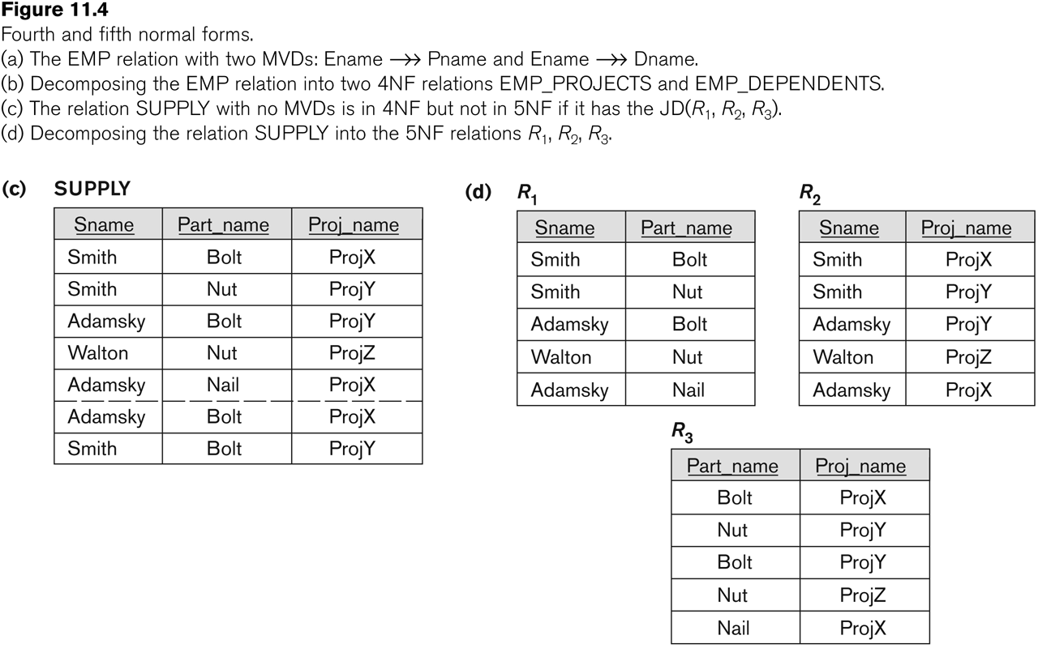
Relation SUPPLY with Join Dependency and conversion to Fifth Normal Form
Slide 11- <number>

Slide 74
Domain-Key Normal Form (DKNF)
Definition:
  A relation schema is said to be in DKNF if all constraints and dependencies that should hold on the valid relation states can be enforced simply by enforcing the domain constraints and key constraints on the relation.

